Slide 1
DJUNGLE !!
Welcome to The largest Job site

Slide 2
What it’s about!!
This is basically a website that helps candidates to find job of their choice in any place around the world and companies to get eligible candidates for their jobs.

Slide 3
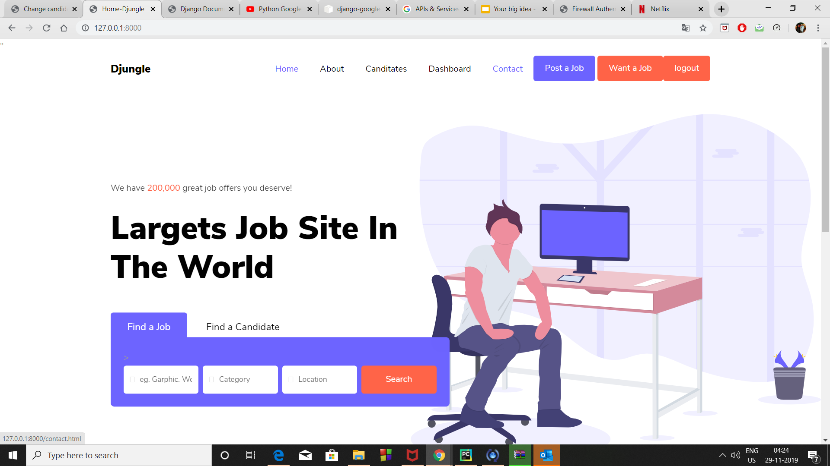

Slide 4


1. Home page
It is the base of our website and contain various features that form the core of Djungle
login/register Helps the new user to get registered via filling information in register form
Any registered candidate can login using his or her unique username and password
Dashboard Only visible to cand who are logged in into the website.
It gives user a personalized experience

Slide 5
2. Dashboard
Benefits
Only visible to cand who are logged in into the website.
It gives user a personalized experience
It contains a dynamic blog feed
Only those users who are logged in can post blogs expressing their ideas to each member of community.
It also contains a feature for getting a list of offered interviews.

Slide 6
Dynamic blog feed
That’s what make our dashboard special …

Slide 7
3.logout
It is shown only when the user is logged in and is used for sign out.
Most of the features are available only for signed in candidates, so once you logout you cannot enjoy them anymore.

Slide 8
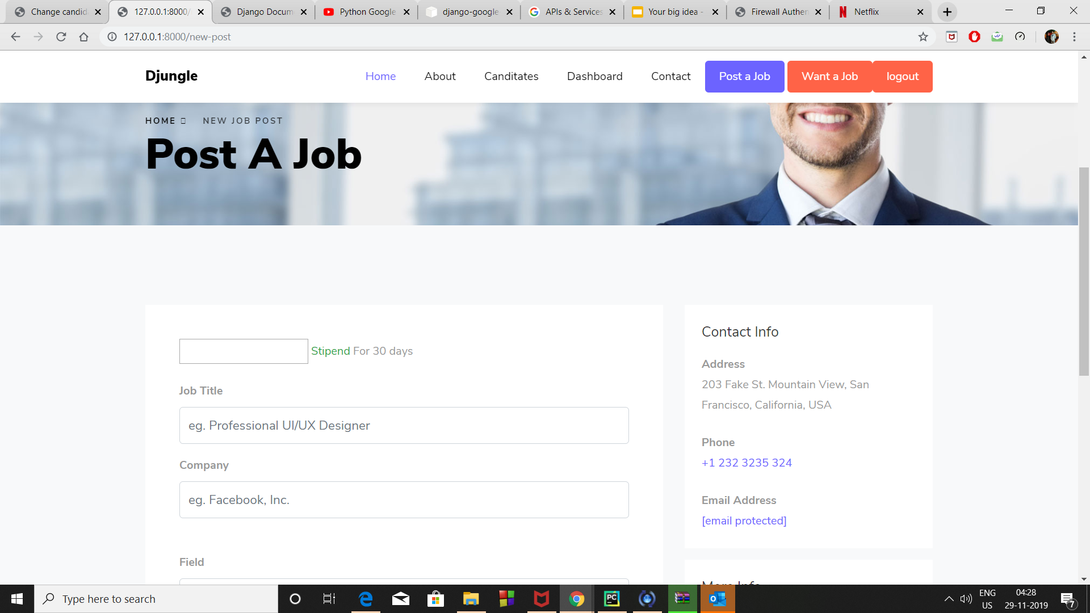
POST A JOB
Looking for quality candidates just use the post a job feature ,put in the details and interested candidates will aproach you

Slide 9
Looking for a job in certain field and for certain time at your location..Don’t worry use our Find a job feature.

Slide 10
Find a job
Fill in the details and get a list of jobs at your feet ,just apply to them through your email

Slide 11
Startup! Don’t know how to hire !!
We are here at your service with our easy to use interface and candidates from all over the world.
JUST put in the field of interest , location of your company and type of employees you require and sit back ….

Slide 12
As soon as your enter details you will get a list of eligible and willing candidates ….
Shortlist feature
Helps you to contact the candidates of your choice ,just select and put in details
and the candidates will get a notification about your company in their profiles

Slide 13

Candidates page
It contains the list of all of our registered users ,with a options for companies to shortlist them for jobs and interviews on the basis of their CV and profile...
Money
Please offer high stipends to our users…...

Slide 14
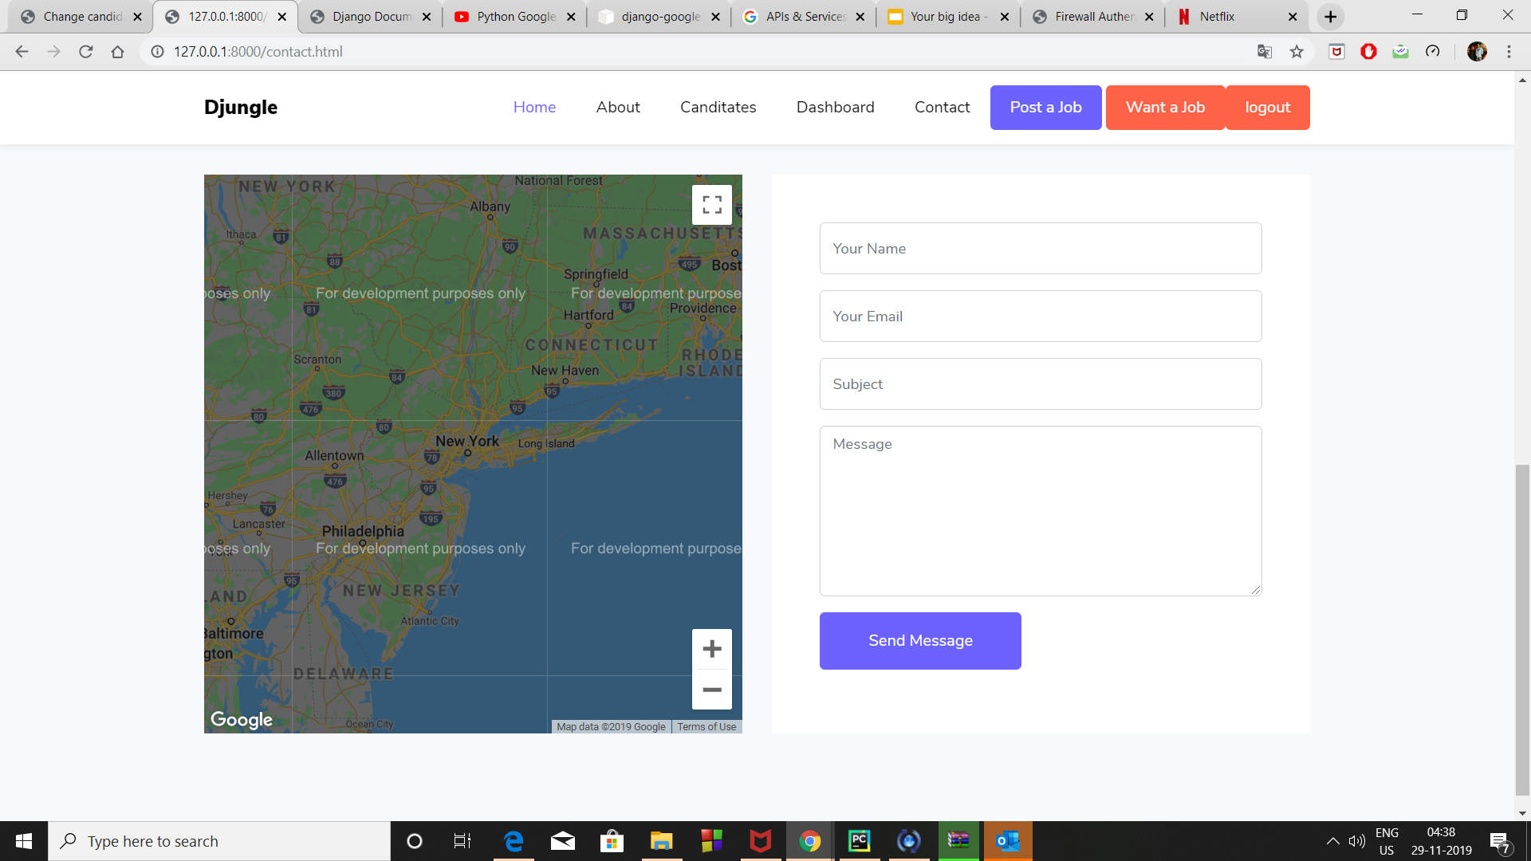
Contact us.
You can easily get to using the our static location in the contact us page..

Slide 15
JUST click on the mail button and it will direct you to your mail service for contacting us.
PLEASE FILL THE BOX AT THE COMMENT PAGE IF YOU TO INQUIRE ABOUT ANYTHING AND EVEN IF YOU WANT TO GIVE SUGGESTIONS

Slide 16
Thank you !!

